Slide 1
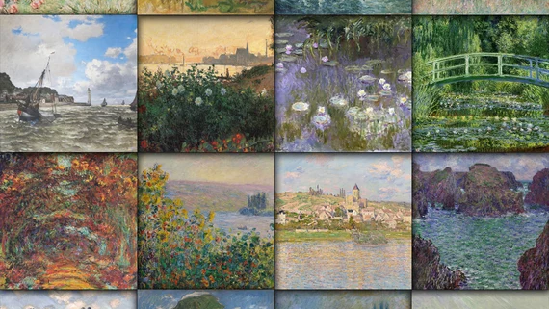
Artificially Creative Demo 2
Arun Agarwal, George Aeillo, Eric Nguyen
Notes:
Arun

Slide 2
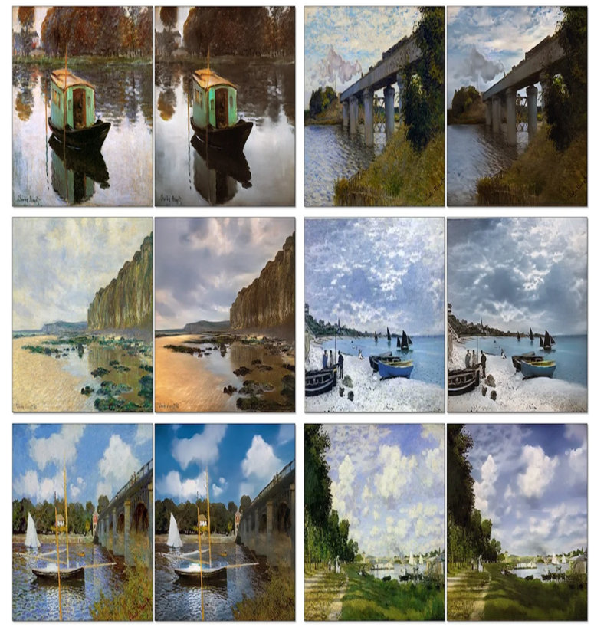
Competition Introduction/ Business Understanding (Recap)
After taking a picture of a beautiful scenery, have you ever wondered what would it look like if a famous painter was there and made a painting of it?
Focus: translating a photograph to a Monet style painting
“Monet-ifying” an image
Style Transfer - transfer an image from one style to another
Imitate color choices and brush strokes
Notes:
Arun

Slide 3
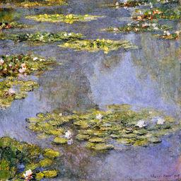
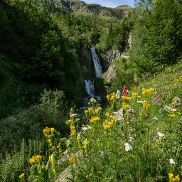
Data Acquisition (Recap)
Both the photos and the Monet data was given to us in files from Kaggle
300 Monet paintings sized 256x256 in JPEG and TFRecord formats
7028 photos sized 256x256 in JPEG and TFRecord formats
Size: 385.87 MB
Project Focus: modeling and architectures of modern data science techniques
(rather than the data acquisition)
Monet Example
Photo Example
Notes:
Arun

Slide 4
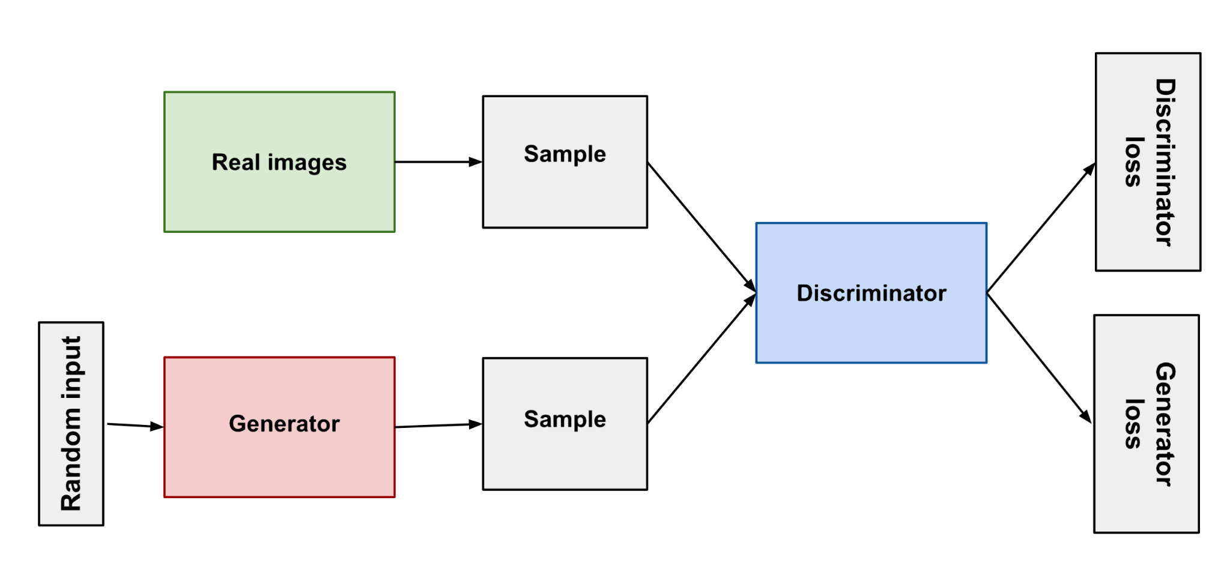
GAN Description (Recap)
Notes:
George
The unique style of Claude Monet, such as his color choices and brush strokes, can now be imitated thanks to algorithms called Generative Adversarial Networks (GANs) (3). As shown in the diagram below, the first component of the network acts as a “detective” that is trained to distinguish between real examples and fake examples that are generated by the second “generator” component. In training, the “generator” component learns to train fake examples that are identical to the real examples, so the “detective” component is only 50% accurate.

Slide 5
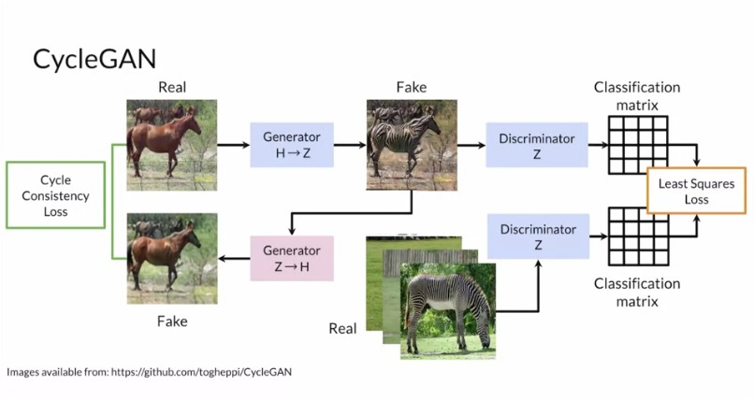
CycleGAN Description (Recap)
Notes:
George: CycleGAN has more losses than ordinary GANS. Have the discriminator loss and the generator loss but have this additional cycle consistency loss that ensures that the image is the same after being pushed back into different generators. Also, touch upon identity loss for models.

Slide 6




New Work Overview
Exploratory Data Analysis
Adjusted model parameters (steps per epoch, batch size)
Data Augmentation
Adjusted generator loss function to include label smoothing
Built website skeleton
Implemented FID score on Kaggle
Notes:
Arun

Slide 7
Shift in Mindset: Application to New Artists
Shift: Competition Placement → General and Interactive Models for Multiple Artists
Now make full use of all training data provided by authors
Gather and use artist data for Ukiyo-e-e, Van Gogh, and Cezanne
Transformed into TFREC Format
Developed standardized train/test split based on CycleGANs’ authors data
10% augmentation to training data and added it to testing data
We do not crop in these new augmentations to reduce pixelation
Notes:
George

Slide 8
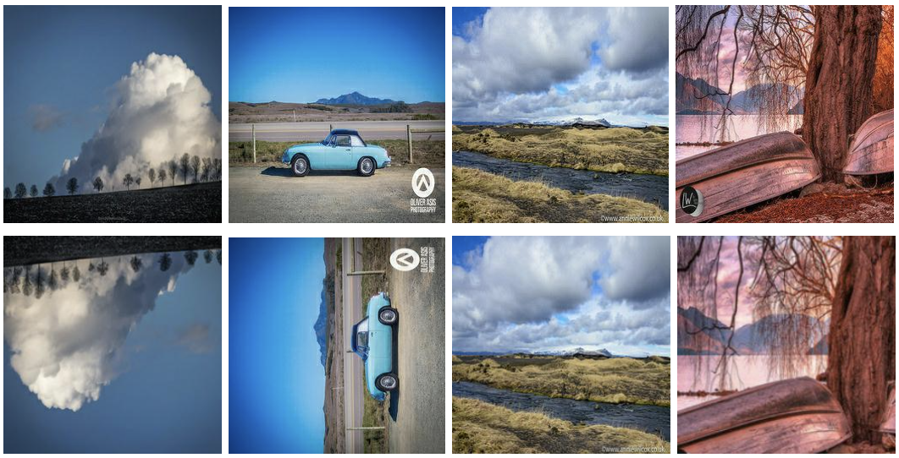
Data Acquisition Changes (Competition Specific)
Business/Problem Understanding remains the same
Most of Data Acquisition process remains the same
Added data augmentation to our basic model, consisting of crops, flips, and rotations
Examples of augmented images using resizing, cropping, rotation, and flipping
Notes:
Arun

Slide 9
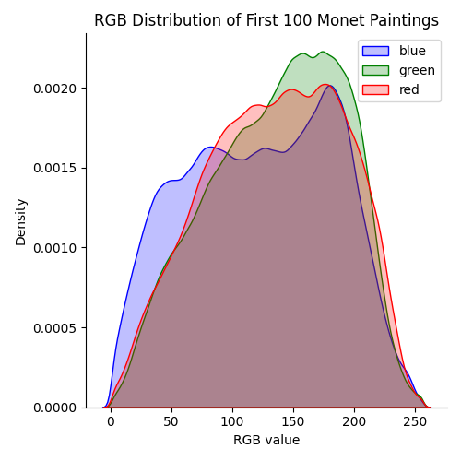
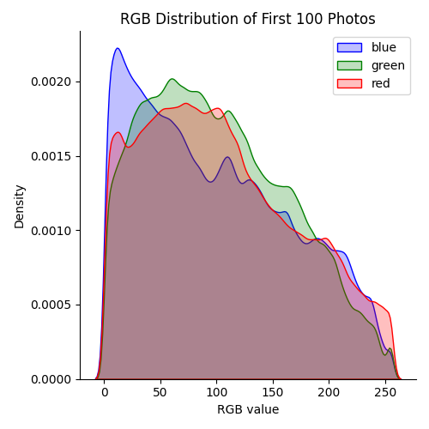
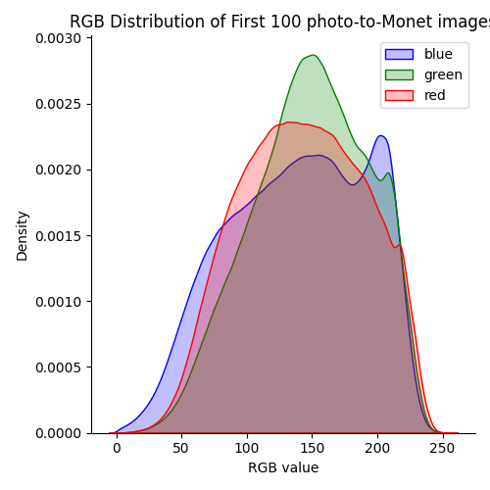
EDA: RGB Distribution
RGB distribution of the first 100 Monet paintings (left), the first 100 photos (middle), and the first 100 generated photo-to-Monet images (right), with zeros excluded
Notes:
Arun
(the zeros are excluded since they distort the plot)—we observe that when generating the photo-to-Monet images, the images tend toward the RGB distribution of the Monet paintings as expected. Therefore, these distributions serve as sort of a sanity check that our model is transferring the color/style well.

Slide 10
Baseline Model → New Model
CycleGAN
120 epochs
Adam optimizer
Loss rate = 0.0002, Beta 1 = 0.5
~2 hours
Within 3-hour limit for TPU
TPU v3-8
Kaggle Notebook
Steps per epoch = number of Monet samples
Batch Size = 1
CycleGAN
30 epochs
Adam optimizer
Loss rate = 0.0002, Beta 1 = 0.5
~2.75 hours
Within 3-hour limit for TPU
TPU v3-8
Kaggle Notebook
Added data augmentation & label smoothing
Steps per epoch = number of photo samples
Batch Size = 4
Notes:
Eric

Slide 11
Deployment (Kaggle)
Kaggle was used for model evaluation and development
We choose Kaggle due to HPC reliability issues along with access to a TPU which significantly speeds up our training
This involved designing various notebooks to allow “plugging in” of multiple datasets from different artists to generate different weights along with multiple image files
Notes:
George

Slide 12
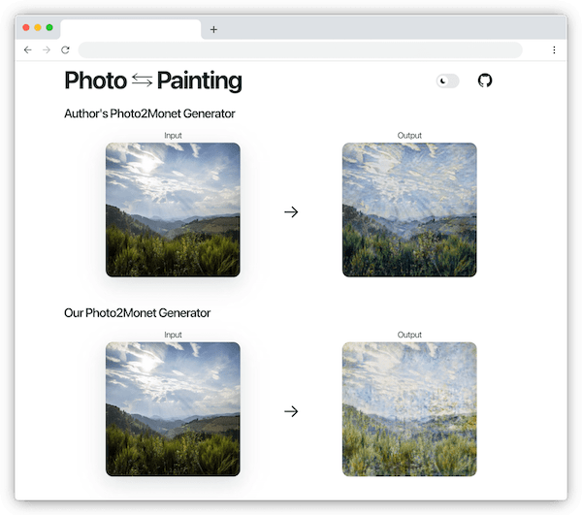
Deployment (Website)
Convert Pytorch model to ONNX (Open Neural Network Exchange) format
Convert TensorFlow model to TensorFlow.js
Deployed with Vercel
Notes:
Eric

Slide 13
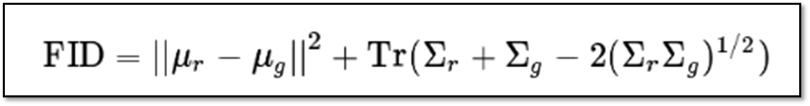
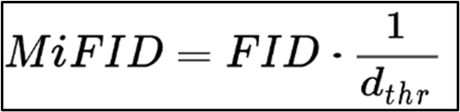
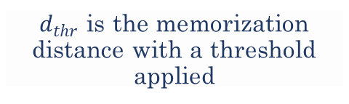
Performance Evaluation from Our Baseline Model
MiFID Score: 51.49337 → 39.73202
Leaderboard: 49/94 → 17/143
- ~52nd percentile → ~12th percentile
Best Scores are still in mid 30s
FID: assesses the quality of images created by a generative model (ex: GAN)
Finds the distance between feature vectors calculated for real and generated images
MIFID: Kaggle-created modification of FID
Adjustments:
MiFID → FID:
FID - more generalizability and widely used
Altered Pytorch-FID code to be used on Kaggle/Google Cloud Platform in “plug and play” fashion
Mean 𝜇, covariance Σ, real images r, generated images g, sum of diagonal elements Tr
$d_{thr}$ is the memorization distance with a threshold applied
Notes:
Arun
The FID compares the distribution of generated images with the distribution of a set of real/ground truth images. Specifically, FID computes the Fréchet distance between two Gaussian distributions fitted to feature representations of the Inception network (7). Here, one uses the Inception network to extract features from an intermediate layer. From there, one models the data distribution for these features using a multivariate Gaussian distribution with mean 𝜇 and covariance Σ.

Slide 14
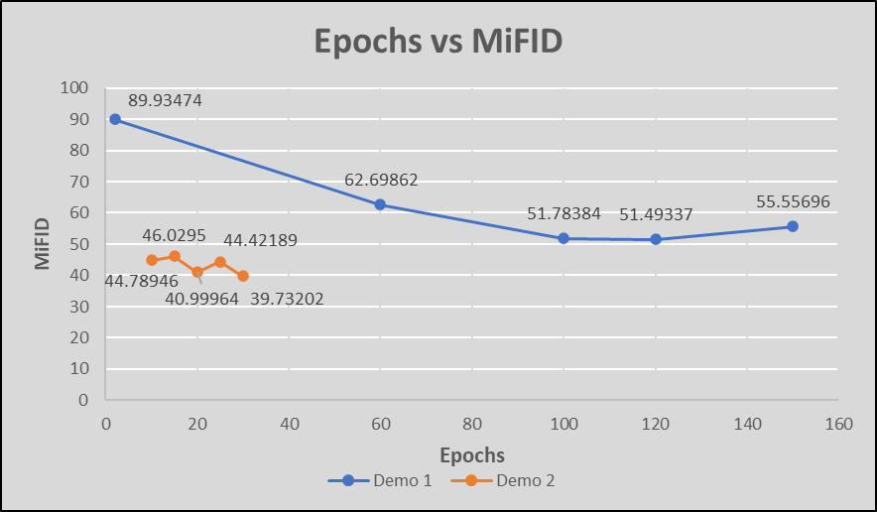
Competition Performance Comparison
Line Graph Displaying Scores for Epochs Tested
Notes:
Eric

Slide 15
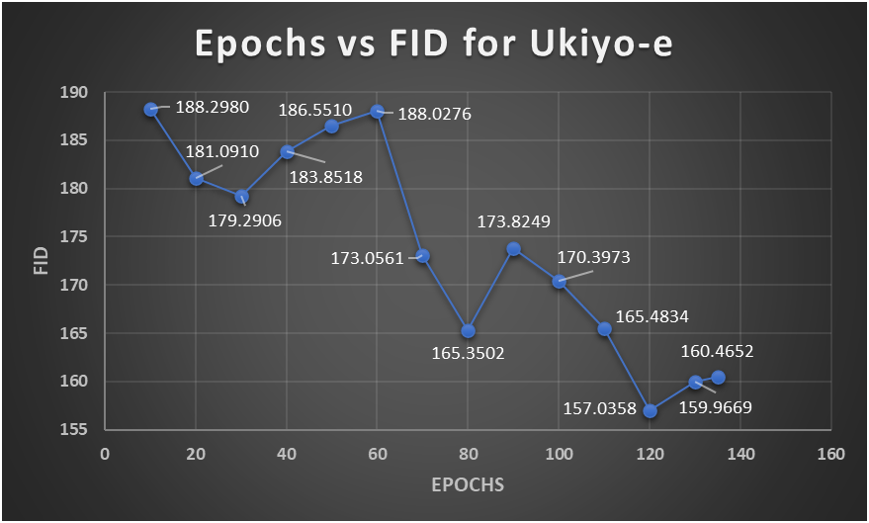
Ukiyo-e Performance Comparison
Line Graph Displaying Scores for Epochs Tested
Notes:
Eric

Slide 16
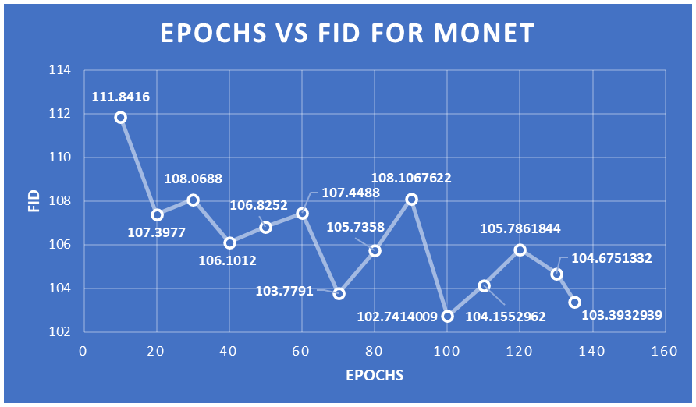
Monet General Performance Comparison
Line Graph Displaying Scores for Epochs Tested
Notes:
Eric

Slide 17
Output Observations: Old → New
Pros:
Good with nature
Cons:
Bad with people, modern architecture, defined lines/boundaries
For detailed photos, the paintings mostly become blurred and hard to discern
Translation among photos varies
Almost everything is pixelated
Good or Bad?
Pros:
Performs well on “sprawling images”
Cons:
Does not perform well on darker images
Does not perform well on non-landscapes
Some images see little change
Detailed photos get blurred sometimes
Notes:
Arun

Slide 18
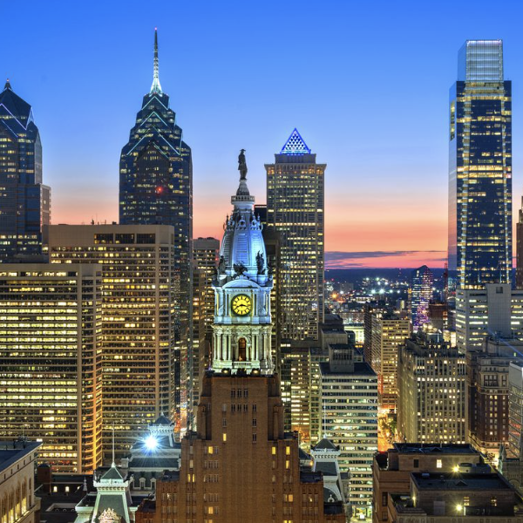
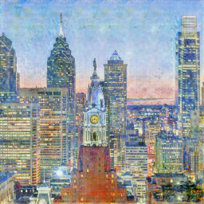
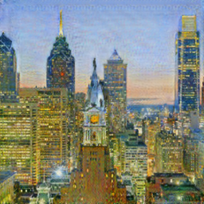
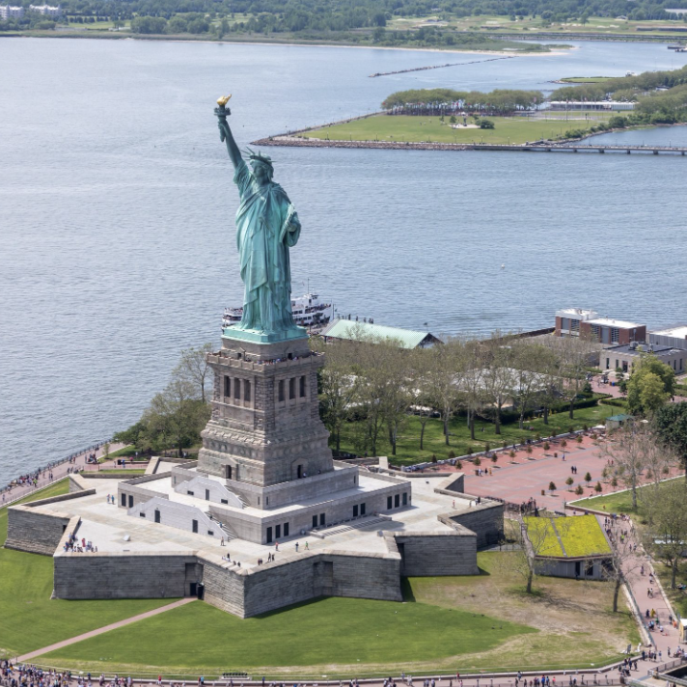
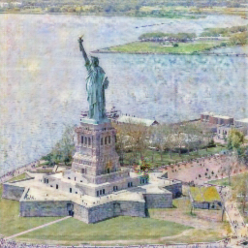
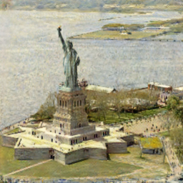
Good Example Outputs
http://clipart-library.com/clipart/pi5rLryMT.htm
https://archello.com/story/91136/attachments/photos-videos/2
Input
Our competition model
Author’s model
Notes:
Arun

Slide 19
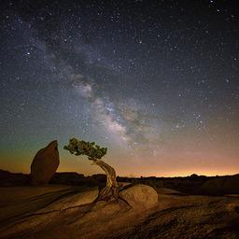
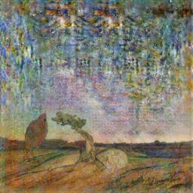
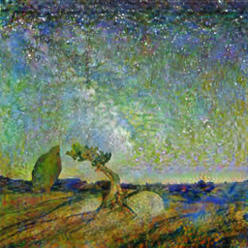
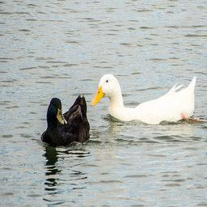
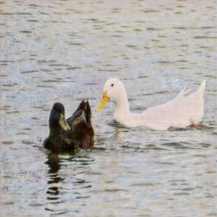
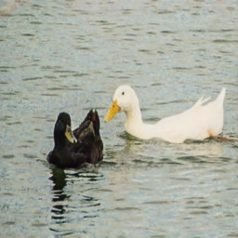
Bad Example Outputs
Input
Our competition model
Author’s model
Notes:
Arun

Slide 20
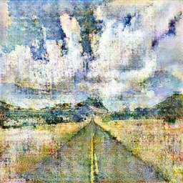
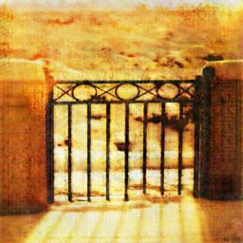
Existing Roadblocks
Memory limits
Model runs out of memory when not generated on TPU, making TPU vital to our work
Time limits
Difficult to implement new changes and play around with epochs
Even on TPU, testing and evaluation is costly and difficult
Runtime limits
Inhibited us from experimenting with other models such as UVC-GAN
Road
(generated)
Block
(generated)
Notes:
George

Slide 21
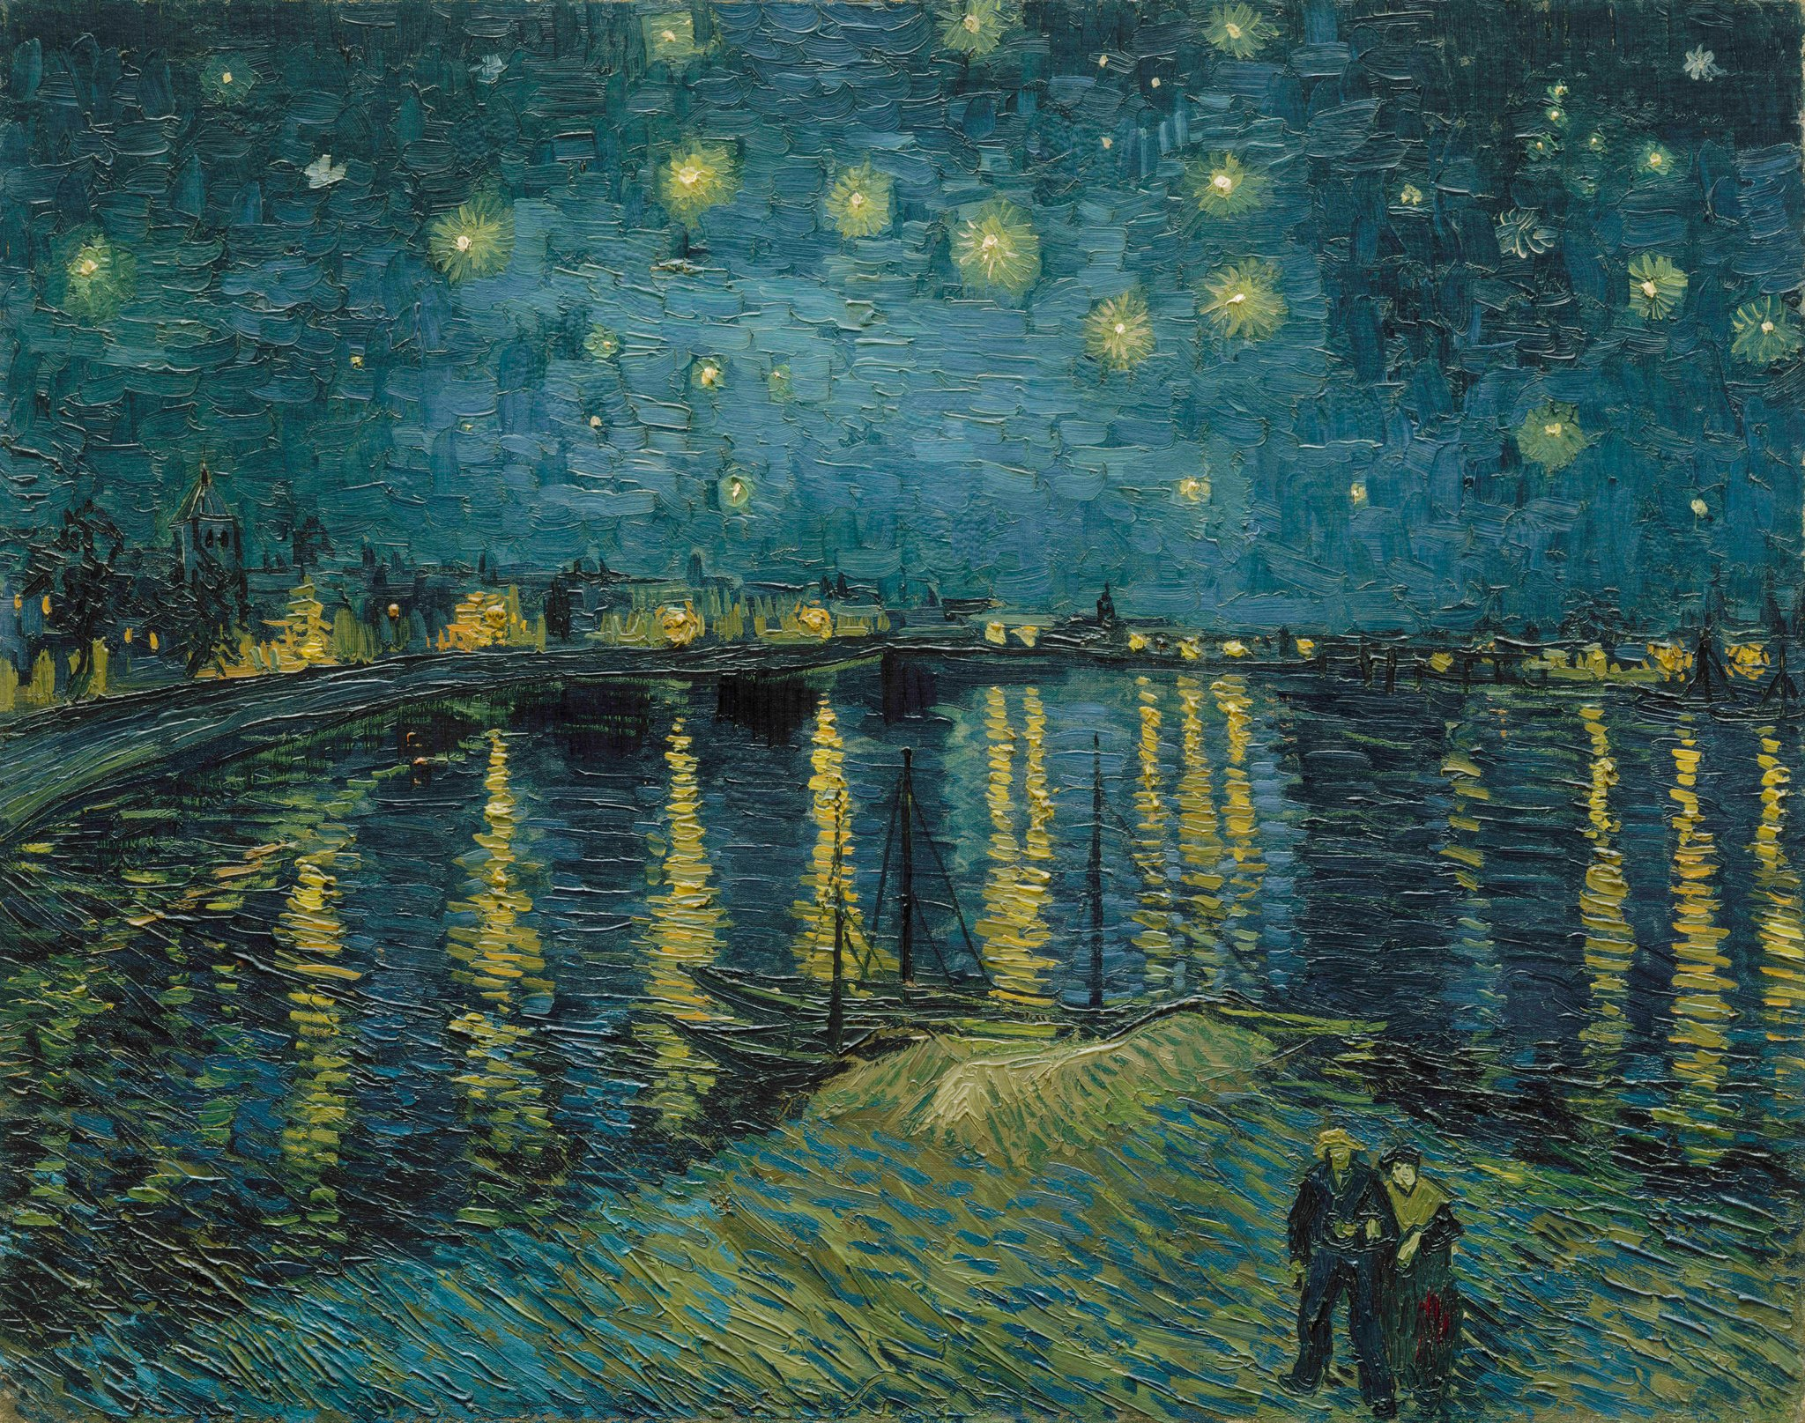
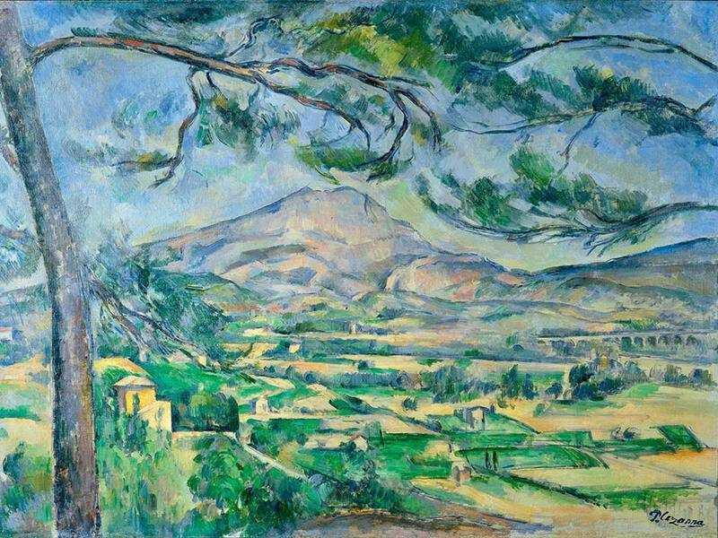
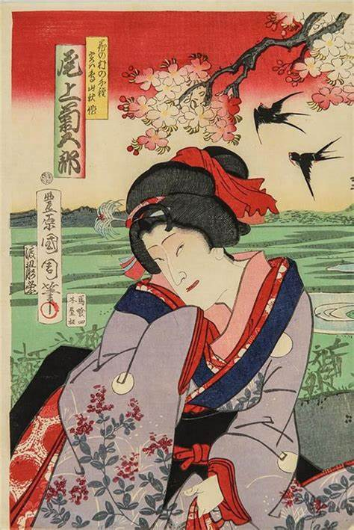
Remaining Steps (Phase 3)
Adding more data samples for other artists (Van-Gogh, Cezanne)
Development and evaluation of models for the other artist
Expanding website for other artists and for artist-to-artist transfers based on author’s weights
Van Gogh
Cezanne
Ukioyo-e
Notes:
George
In the final phase, we will make any finishing touches to our model, as needed. Once our model is completely finalized, we will train and save the weights of the model’s generators in TensorFlow’s “SavedModel” format and convert the saved models to a format that TensorFlow.js can read. Once we have the models saved in a TensorFlow.js-compatible format, we can use TensorFlow.js to load the models onto the website, from which we can accept user-uploaded 256x256 JPG images and produce a style translation on the user images. The user input and generated output will be displayed side-by-side through our web interface, where the user will be given the option to download their generated image. In this phase, the deliverables that we will produce include the second bimonthly progress report, the data report, the model and performance report, and a final demonstration of our project including our interactive dashboard.

Slide 22
References
Our GitHub Repository
I’m Something of a Painter Myself | Kaggle
CycleGAN: a GAN architecture for learning unpaired image to image transformations (haikutechcenter.com)
This AI Can Convert Paintings Into Photos and Summer Into Winter | PetaPixel
Time Wallpaper (73+ images) (getwallpapers.com)
Van Gogh's Most Famous Paintings (thoughtco.com)
Homer Painting
Van Gogh Painting
Monet Painting
Cezanne Painting
FID Explained
Lot - Various Ukiyo-e Artists (Japanese 18th-Early 19th Century) Actors: Seven Woodblock Prints The... (weschlers.com)

